Slide 1
WELCOME

Slide 2
SRI BALAJI PG COLLEGE (MCA)
BUG PREDICTION MODEL- ADEVELOPER CENTERED
GAJULA AJAY KUMAR 21JX1F0036

Slide 3
INTRODUCTION
Bug prediction techniques are used to identify areas of software systems that are more likely to contain bugs.
These prediction models represent an important aid when the resources available for testing are scarce, since they can indicate where to invest such resources.
The Information They Exploit To Discriminated Between ‟Buggy “ And ‟ Clean” Code Components.
Metric Based Techniques There is a general Consensus On The Fact That No Techniques Is The Best In All Contexts.
Which Circumstances And During Which Coding Activities Developers Tend To Introduce Bugs.

Slide 4
EXISTING SYSTEM
The Chidamber and Kemerer (CK) metrics [36] have been widely used in the context of bug prediction. Basili et al. [1] investigated the usefulness of the CK suite for predicting the probability of detecting faulty classes. They showed that five of the experimented metrics are actually useful in characterizing the bug-proneness of classes.
The same set of metrics has been successfully exploited in the context of bug prediction by El Emam et al. [26] and Subramanyam et al. [27]. Both works reported the ability of the CK metrics in predicting buggy code components, regardless of the size of the system under analysis.
Ohlsson et al. [3] focused the attention on the use of design metrics to identify bug-prone modules. They performed a study on an Ericsson industrial system showing that at least four different design metrics can be used with equivalent results. The metrics performance are not statistically worse than those achieved using a model based on the project size.

Slide 5
DISADVANTAGES OF EXISTING SYSTEM
There is no Product and process metrics Technique during this system.
There is no technique called Structural scattering to seek out bugs effectively.

Slide 6
PROPOSED SYSTEM
The Proposed system is extended the empirical evaluation of our bug prediction model by considering a group of 26 systems.
Compare our model with two additional competitive approaches, i.e. prediction model based on the Focus metrics proposed by posnett et al. and a prediction model Based on structural code metrics, that together with the previously considered models, i.e., the BCCM proposed by Hassan and the one proposed by ostrand et al, lead to a Total 4 different baselines considered in our study.
Provide a comprehensive replication package including all the data and dealing data sets of our studies.

Slide 7
ADVANTAGES OF PROPOSED SYSTEM
This System Implements Research Questions And Baseline Selection Which Is Effective In Fining Bigs.
The System Has a Technique To Detect Bugs Of Mining Software Repositories

Slide 8
HARDWARE AND SOFTWARE REQUIREMENTS
HARDWARE REQUIREMENTS
System : i3
Hard Disk : 500GB
Ram : 512Mb

Slide 9
SOFTWARE REQUIREMENTS
Technology : Java 2 Standard Edition, JDBC
Web Server : Tomcat 7.0
Client Side Technologies :HTML, CSS, JavaScript
Server Side Technologies : Servlets, JSP
Data Base Server : MySQL
Editor : Netbeans8.1

Slide 10
MODULES
Admin
View And Authorize Users
Manager
Project Developers

Slide 11
EXPLANATION OF MODULES
ADMIN
In this module, the Admin has to login by using valid user name and password. After login successful he can do some operations such as View all Project Developers and Authorize, View all Managers and Authorize, View all Team Members based on project, View all Bugs details from team members and manager and given solution with req date and res date. View number of time occures same Bug for a project and give link to show in Chart, View No. Of team members for each project assigned in Chart.

Slide 12
VIEW AND AUTHORIZE USERS
In this module, the admin can view the list of users who all registered. In this, the admin can view the user's details such as, user name, email, address and admin authorizes the users.

Slide 13
MANAGER
In this module, there are n numbers of managers are present. Manager should register before doing any operations.
Once manager registers, their details will be stored to the database.
After registration successful, he has to login by using authorized user name and password.
Once Login is successful manager will do some operations like View all Team Members based on project, Add Projects with Project name and start date and end date, expected date, View all employees and select emp to Add Project, View all added project details and give edit option View all team members defects and give solution or allote to other team members, Add extension dates for the project to deliver, View all projects status from team members, View all complexity of the project while developing

Slide 14
PROJECT DEVELOPERS
In this module, there are n numbers of users are present. User should register before doing any operations.
Once user registers, their details will be stored to the database. After registration successful, he has to login by using authorized user name and password.
Once Login is successful user will do some operations like View Your Profile with company Name, View all Assigned Projects with all details, Set defects and send to corresponding team member, Set defects and send to corresponding team manager, view all solutions based on team member and team manager, View all projects and select your projects to show the status like Open, closed, Completed, With drawn,View all team members defects and give solution, View all assigned Projects extension details, add complexity of the project while developing

Slide 15
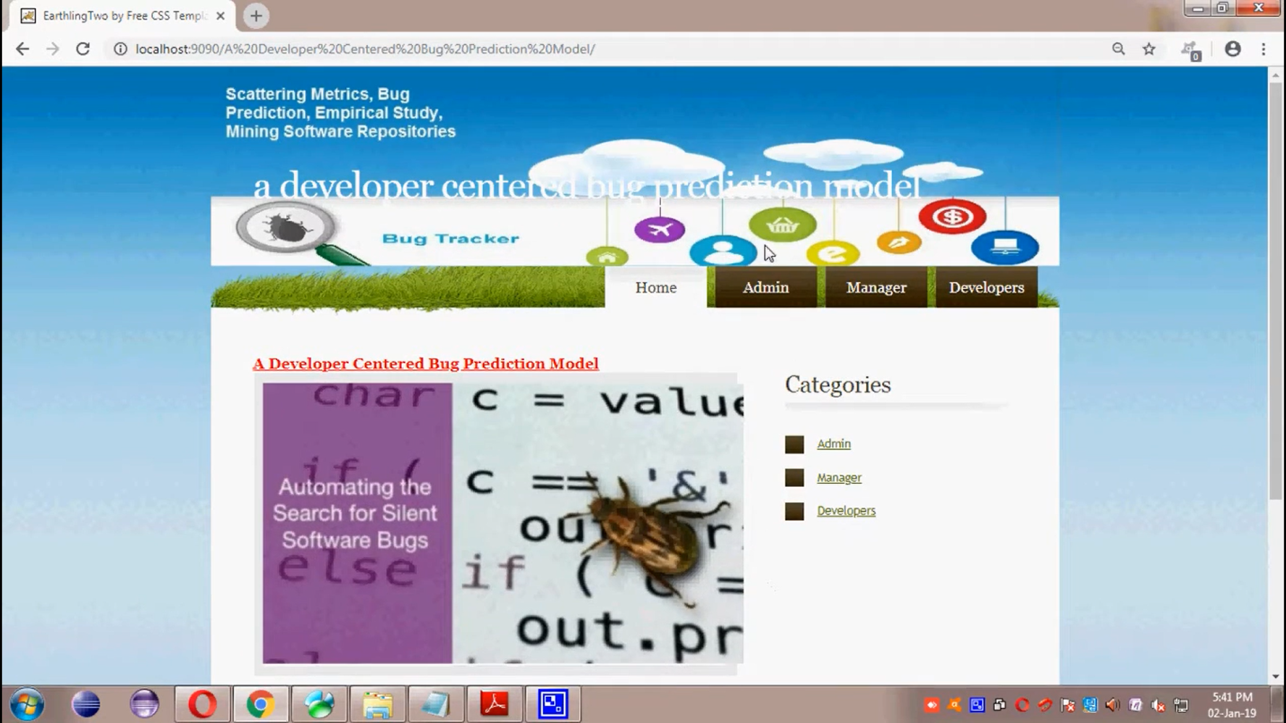
INPUT PROVIDED

Slide 16
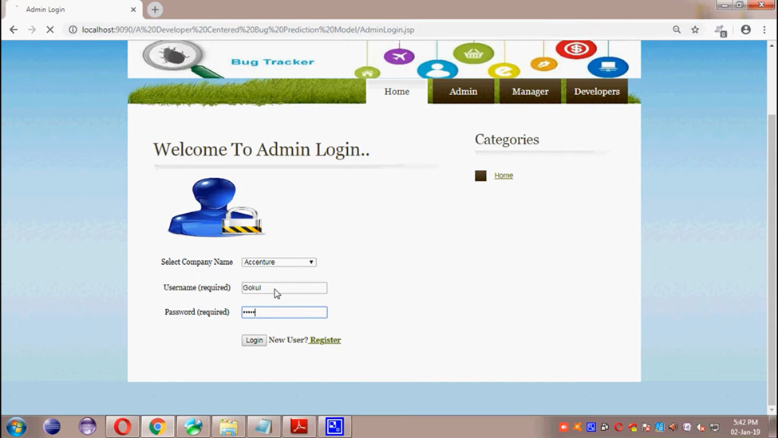

Slide 17
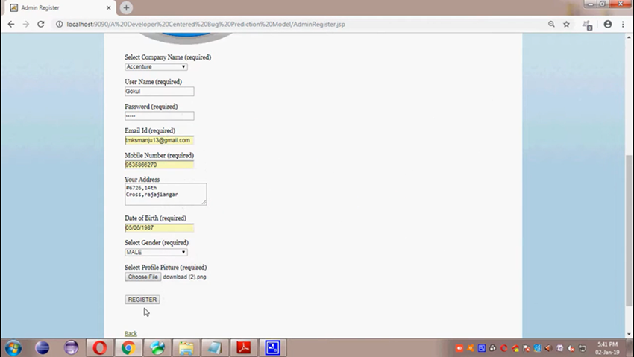

Slide 18
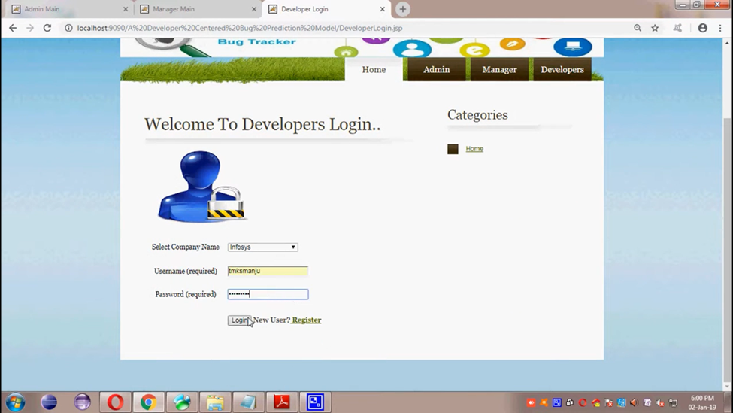
OUTPUT SCREENS

Slide 19
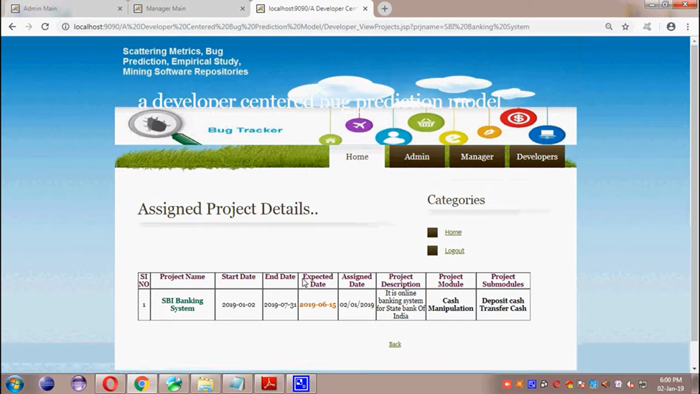

Slide 20
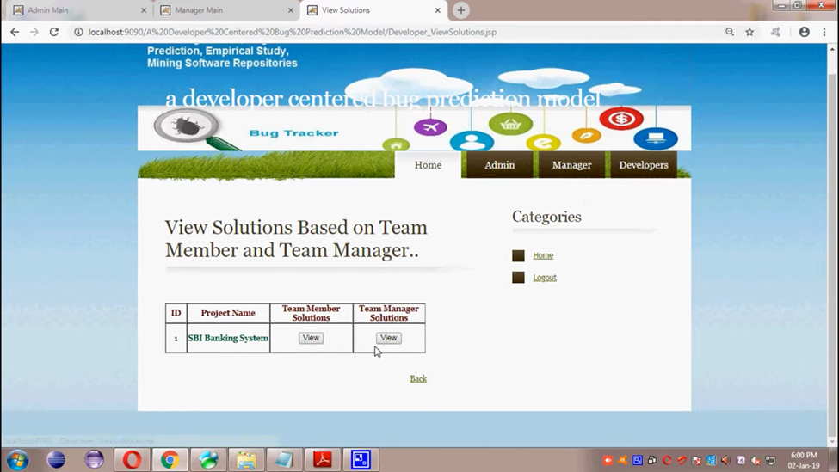

Slide 21
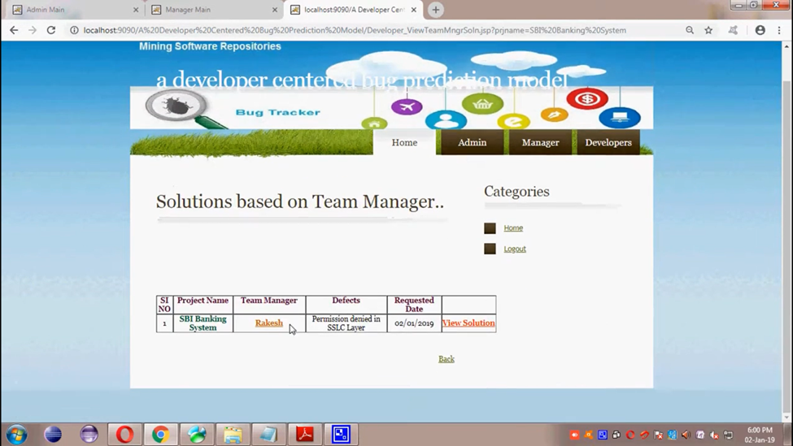

Slide 22
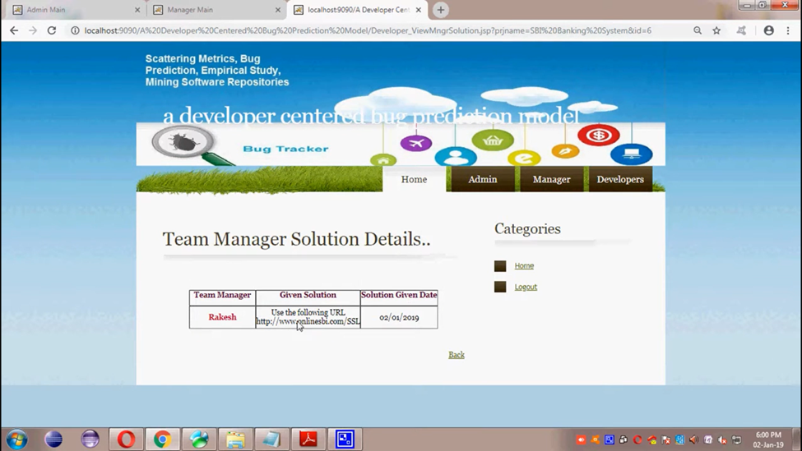

Slide 23
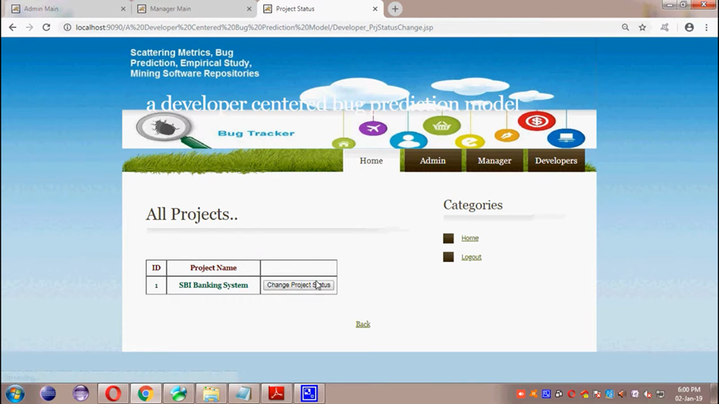

Slide 24
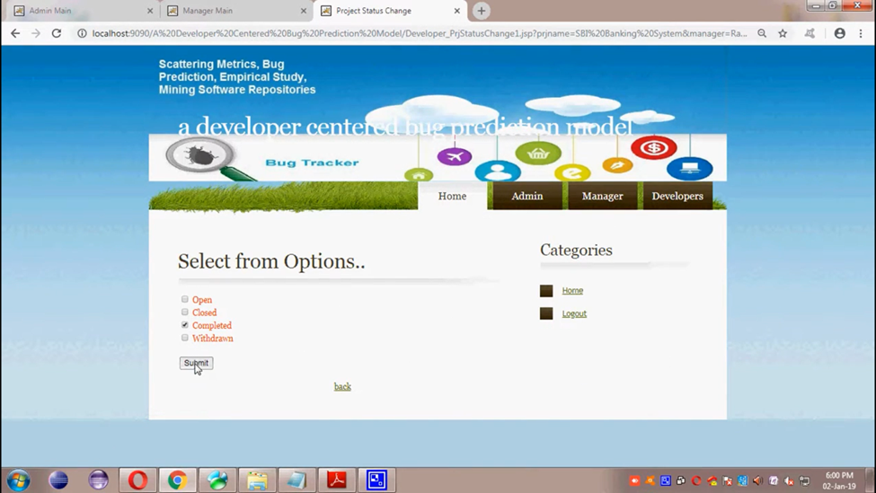

Slide 25
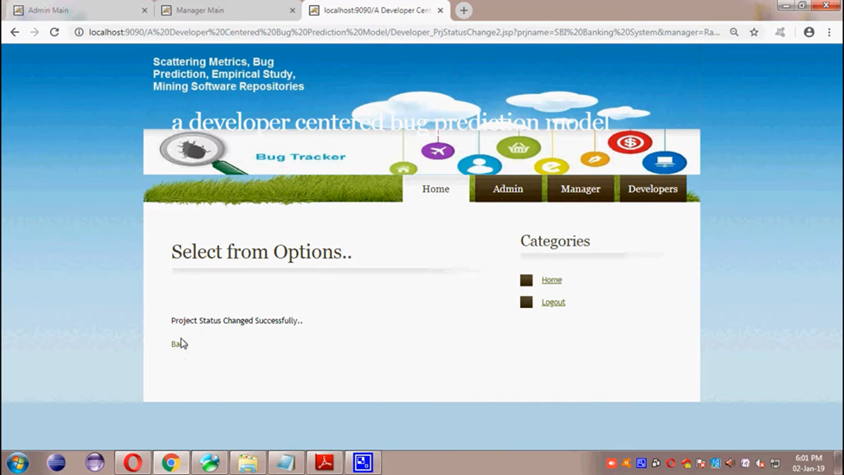

Slide 26
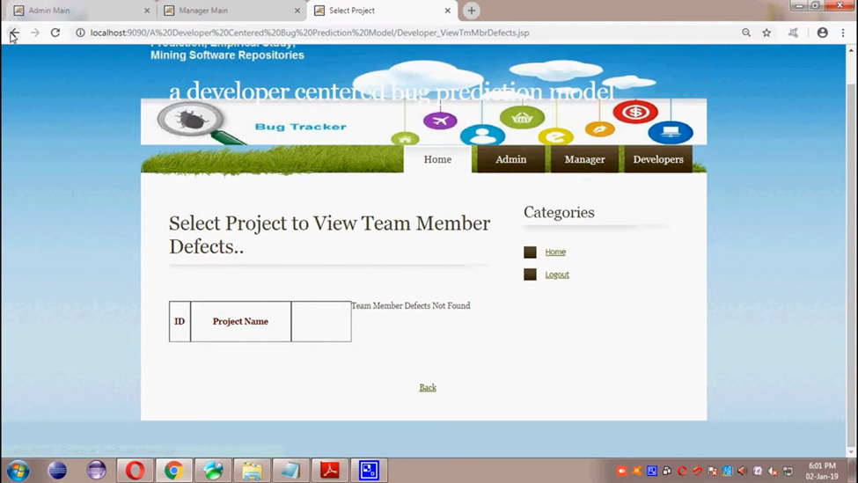

Slide 27
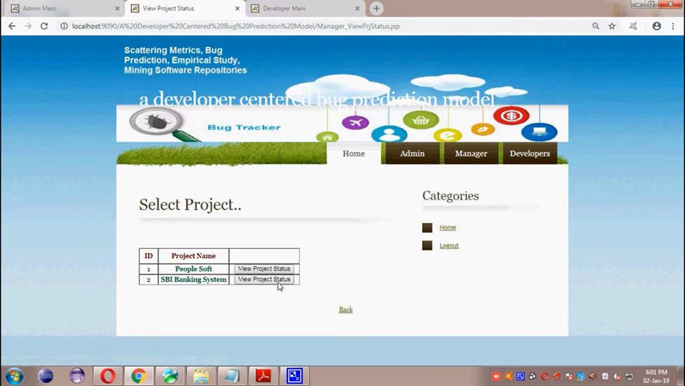

Slide 28
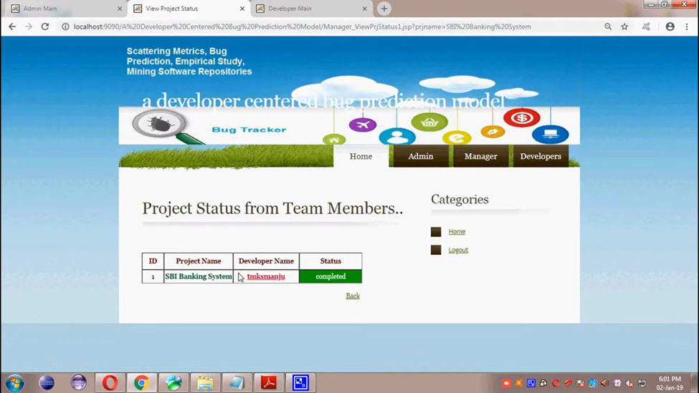

Slide 29
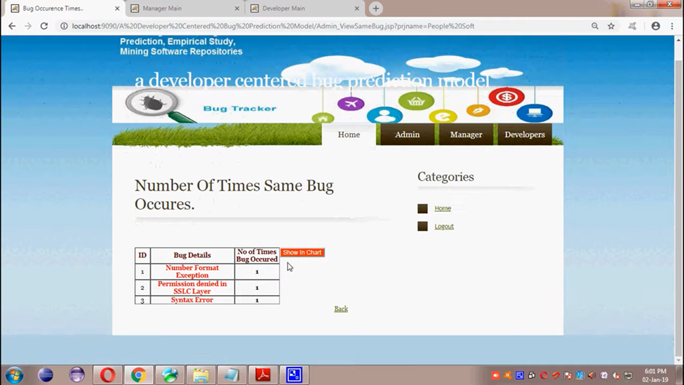

Slide 30
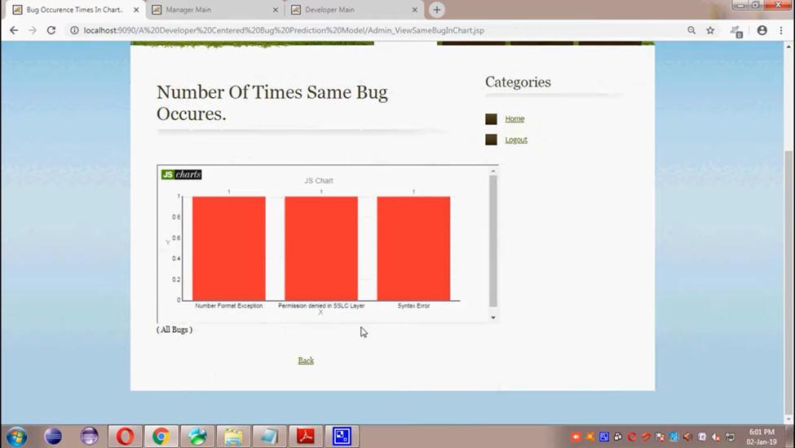

Slide 31
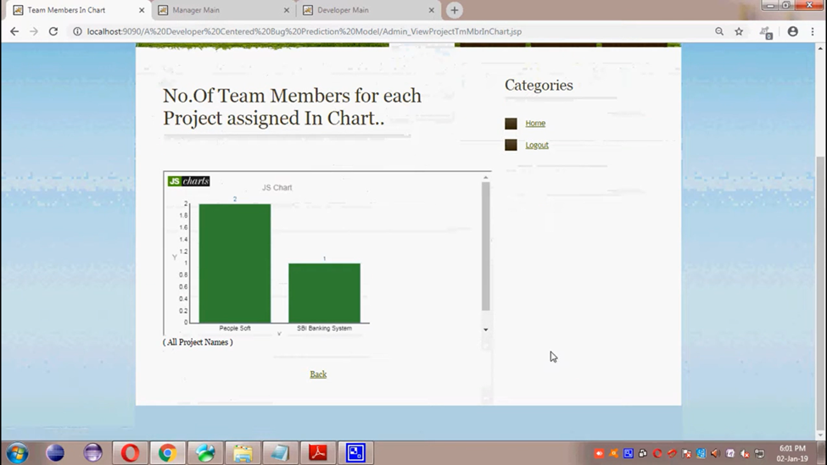

Slide 32
CONCLUSION
A lot of effort has been devoted in the last decade to analyze the inﬂuence of the development process on the likelihood of introducing bugs.
Several empirical studies have been carried out to assess under which circumstances and during which coding activities developers tend to introduce bugs.
the “hybrid” is able to achieve a higher accuracy with respect to each of the ﬁve models taken in isolation, and
the predictors proposed in this paper play a major role in the best performing “hybrid” prediction models

Slide 33
REFERENCES
V. Basili, L. Briand, and W. Melo, “A validation of object-oriented design metrics as quality indicators,” Software Engineering, IEEE Transactions on, vol. 22, no. 10, pp. 751–761, Oct 1996.
T. Gyim´ othy, R. Ferenc, and I. Siket, “Empirical validation of object-oriented metrics on open source software for fault prediction,” IEEE Transactions on Software Engineering (TSE), vol. 31, no. 10, pp. 897–910, 2005.
] A. E. Hassan, “Predicting faults using the complexity of code changes,” in ICSE. Vancouver, Canada: IEEE Press, 2009, pp. 78–88.

Slide 34
THANK YOU

